Slide 1
ISO Developer’s Toolkit - Installing on Windows 2015 CDI Workshop
May 11, 2015
Stan Smith, USGS

Slide 2
Ruby (not to be confused with ‘Ruby on Rails’) is a dynamic, Object Oriented, cross-platform, open-source, general-purpose programming language written in C.
Ruby project on GitHub - https://github.com/ruby
Interpretive language
The MinGW compiler is used for Windows installations

Slide 3
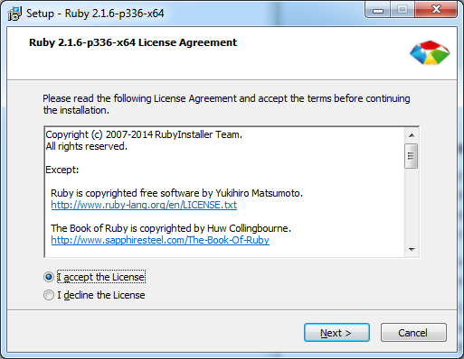
Download the appropriate Windows installer from http://rubyinstaller.org/ . I used Ruby 2.1.6 x64 for this example. Version for 2.2.0 is available but I like to give time for RubyGem providers to test against new versions.
Navigate to the download directory and double-click the self-extracting 7z file.
Accept the license …

Slide 4
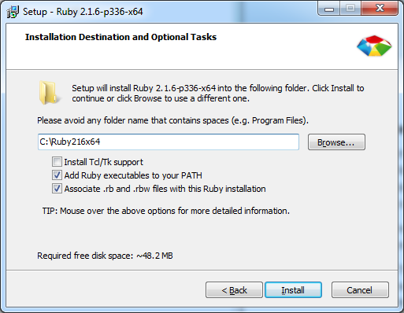
Provide a location for the installation. I use the root of the C:\ drive to be sure access is simple for all Ruby programs. I also name the folder with the version of Ruby being installed so I can install and test newer version as they become available.
Be sure to choose to add Ruby to your PATH and make the association with .rb and .rbw file types.
Click ‘Install’ and the process will complete.

Slide 5
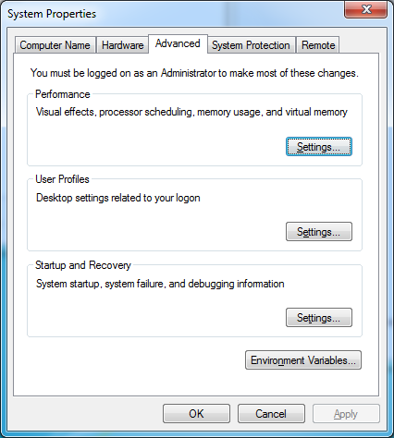
Check that the path was added to the Windows Environment Variables. The PATH can be viewed and edited from the ‘Advanced’ tab of ‘System Properties’. Click the ‘Environment Variables …’ button.

Slide 6
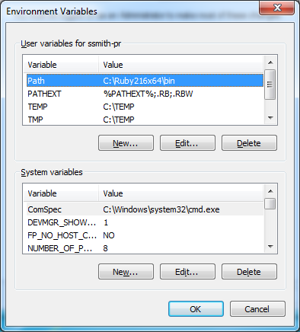
Be sure you see the path to the folder you installed Ruby in.

Slide 7
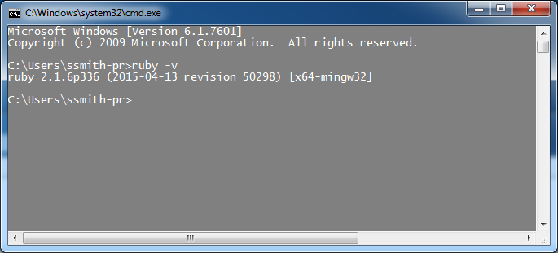
With Ruby installed, test that Ruby installed properly in your environment. Start a command window (launch CMD from the start menu).
From the prompt check the version of Ruby installed: > ruby –v

Slide 8
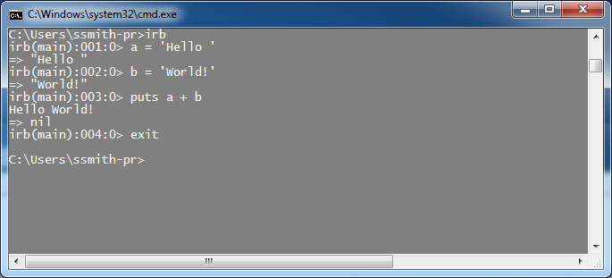
You can also start the ‘Interactive Ruby’ console and write a few lines of Ruby code just to see that all works properly.

Slide 9
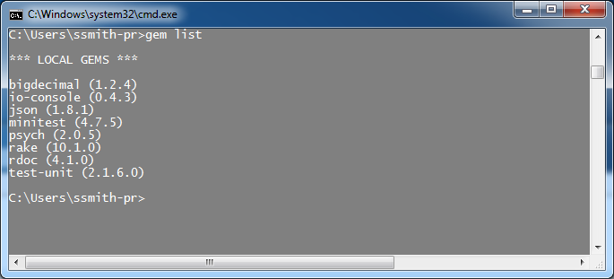
Ruby gets many benefit from the rich repository of RubyGems or code libraries written to easily plug into and be consumed by Ruby programs. Check the gems installed with the Ruby installation: > gem list
Note that the RubyGem ‘gem’ is also installed although not listed.

Slide 10
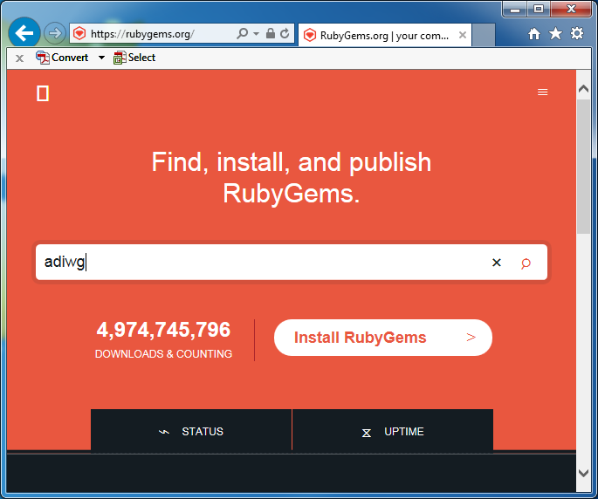
Thousands of other RubyGems are available for download at http://rubygems.org/ including those written by ADIwg. Enter ‘adiwg’ and press ‘Enter’.

Slide 11
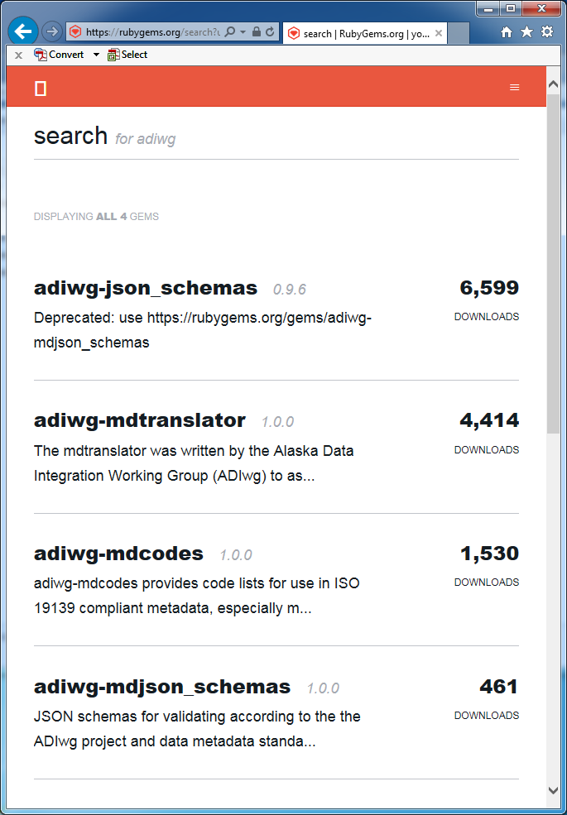
The ADIwg gems available are listed along with their current download counts.
In this case we want to install the ‘adiwg-mdtranslator’ gem. From the command line type: > gem install adiwg-mdtranslator

Slide 12
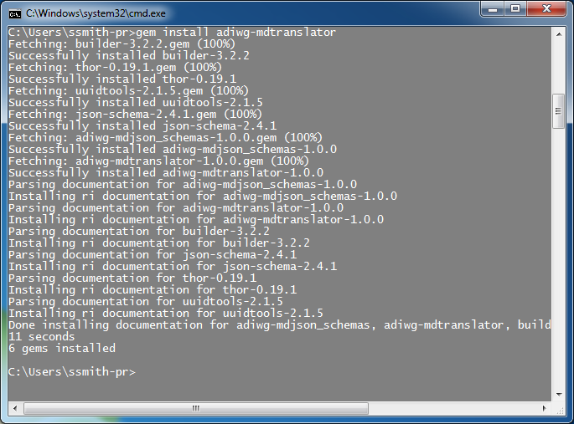
The adiwg-mdtranslator gem will install along with all its other RubyGem dependencies. Notice 6 gems were installed.

Slide 13
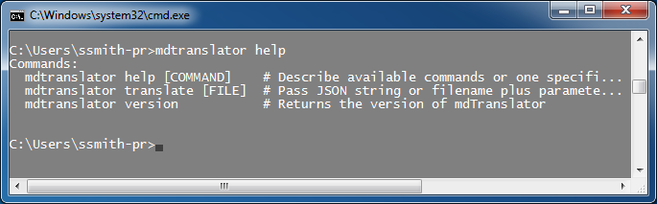
Since the adiwg-mdtranslator gem provides a Command Line Interface (CLI) we can check its installation by typing: > mdTranslator help

Slide 14
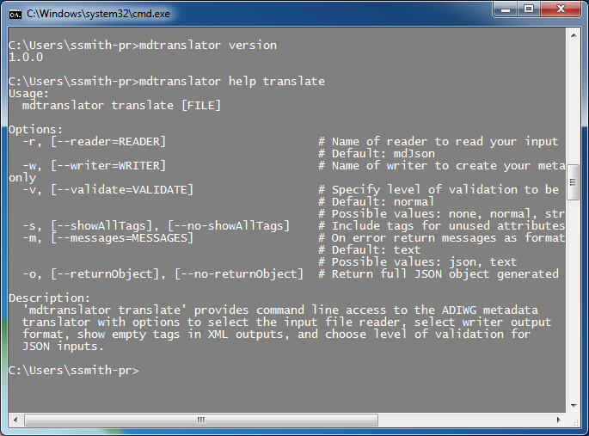
We can check the version and get more help on commands such as ‘translate’.
Installation of Ruby and the mdTranslator are complete. We could use mdTranslator from the command line and pipe the result to a file.

Slide 15
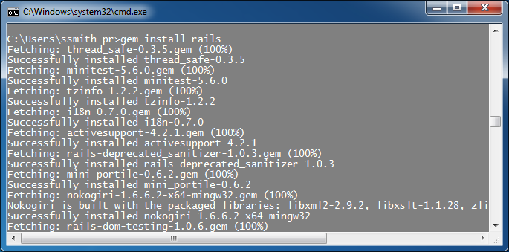
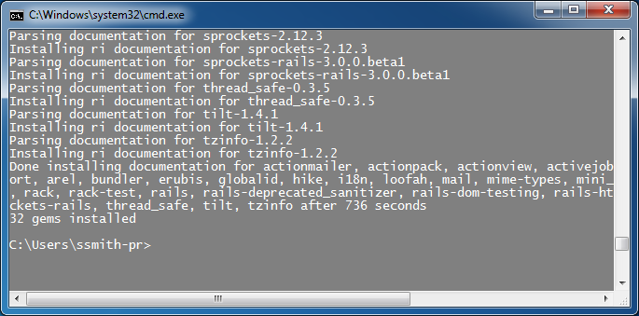
If we wish to also use mdTranslator within a local web service we need to install Ruby on Rails (Rails).
With Ruby install, use Gem to do the work for us. > gem install rails.
Notice Rails installed another 32 gems.

Slide 16
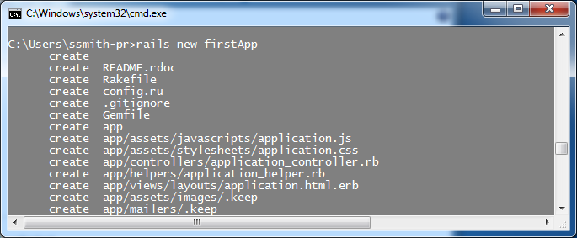
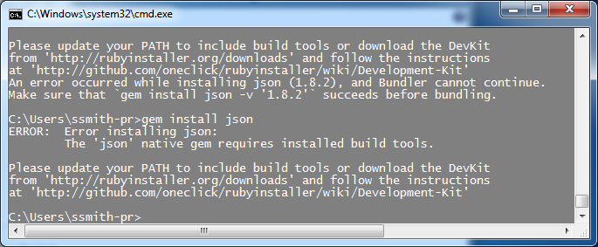
To test the Rails installation ask rails to create a new website. From the command line type: > rails new firstApp. ‘firstApp’ will install in the directory at your current prompt, in this case C:\Users\ssmith-pr\firstApp.

Slide 17
After many lines reported back the web site failed to complete because the ‘json’ gem version 1.8.2 did not provided a version compiled for Windows. Unfortunately, glitches are common on Windows installations and the installation of DevKit will generally be required at some point. Best do it now!
Download the appropriate version of DevKit from http://rubyinstaller.org/downloads/ . More information about installing DevKit can be found at https://github.com/OneClick/RubyInstaller/wiki/Development-Kit .
I also install DevKit at the root of the C:\ directory.

Slide 18
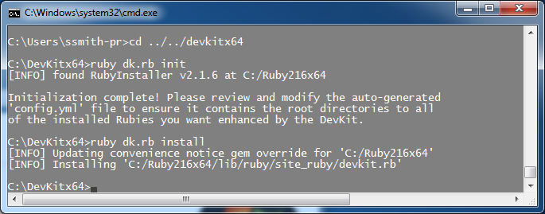
To connect DevKit with the Ruby installation, navigate to the DevKit install directory.
From the command line type: > ruby dk.rb init
Next type: > ruby dk.rb install

Slide 19
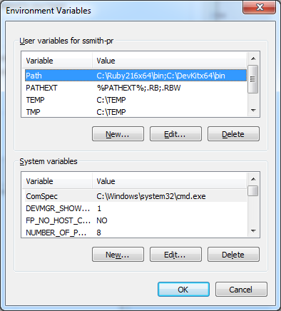
With DevKit installed, check that the PATH variable was properly updated.

Slide 20
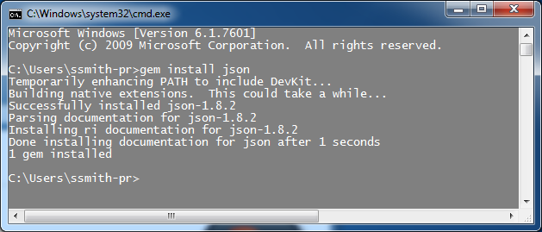
With the PATH now defined to DevKit, try for a properly installed version of the json gem. From the command line type: > gem install json
And it works!

Slide 21
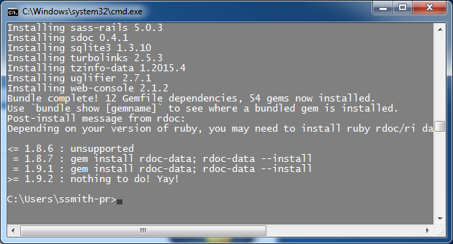
Try again to have Rails build a new web site. From the command line type: > rails new firstApp
After many lines you should see a successful completion.

Slide 22
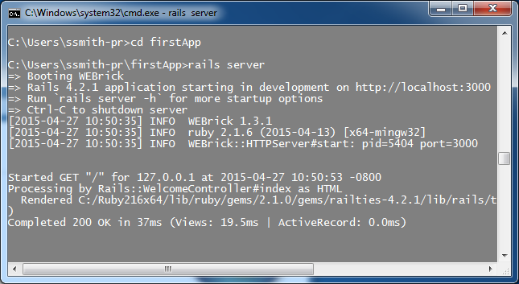
To test the new web site navigate to its directory and start the rails server. From the command line type: > rails server
Rails will start its default web server ‘WEBrick’ on localhost port 3000.

Slide 23
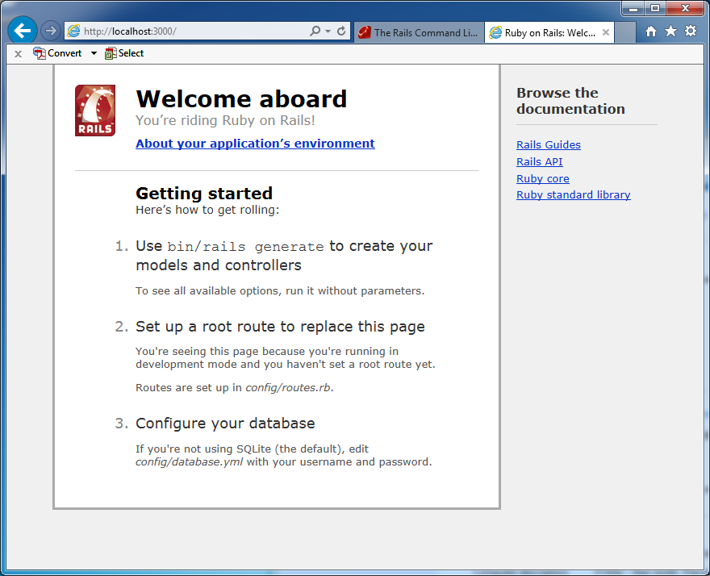
Open you browser and navigate to http://localhost:3000. You should see the Rails ‘Welcome aboard’ page.

Slide 24
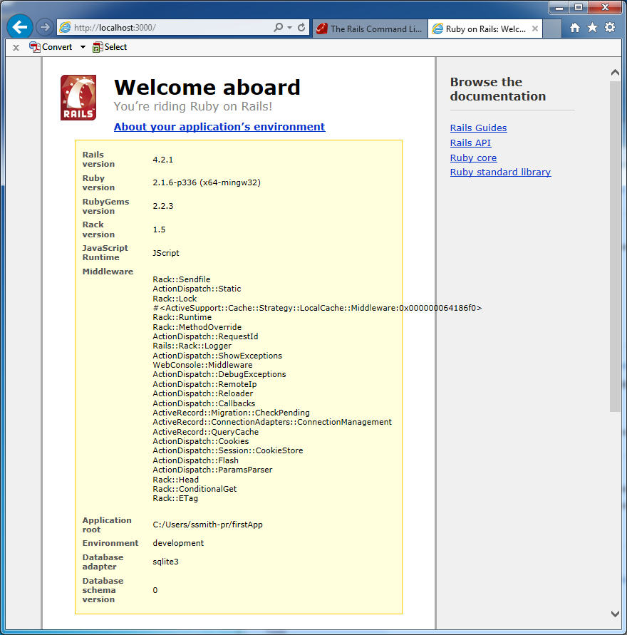
For more information about the installation click the ‘About you application’s environment’ and Rails will display information about the software and version.
Time to start developing! -- Almost --

Slide 25
Another common problem with Rails on Windows x64 is the gem ‘tzinfo’. Windows does not include a time-zone table with the operating system so you need to download one. Rails will automatically set one up for Windows x32 but not x64. Edit the ‘Gemfile’ line …
gem 'tzinfo-data', platforms: [:mingw, :mswin]
to include support for Windows x64
gem 'tzinfo-data', platforms: [:mingw, :mswin, :x64_mingw]
Run RubyGem ‘bundler’ from the terminal prompt to update the gem files. Type: > bundle update.
Now you are ready.

Slide 26
Questions?
Discussion?

